Slide 1


MARATHA MANDAL'S NATHAJIRAO G. HALGEKAR INSTITUTE OF DENTAL SCIENCES & RESEARCH CENTRE
Visual guide on Mastersoft

Slide 2
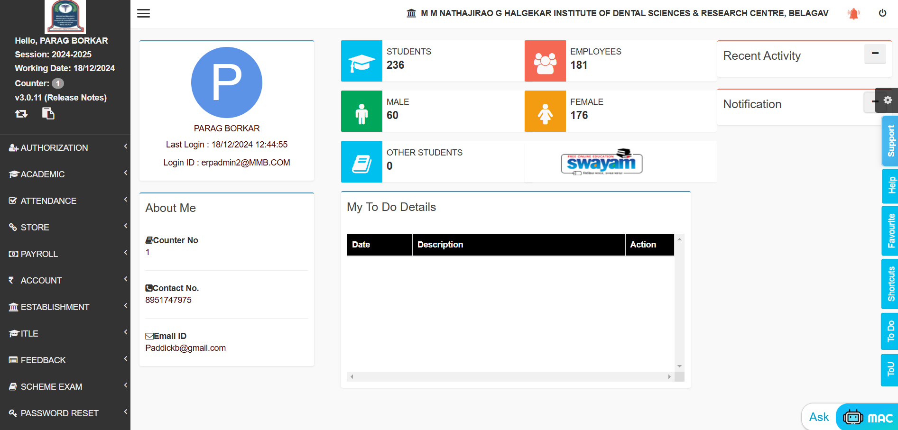
Dashboard Overview

Slide 3
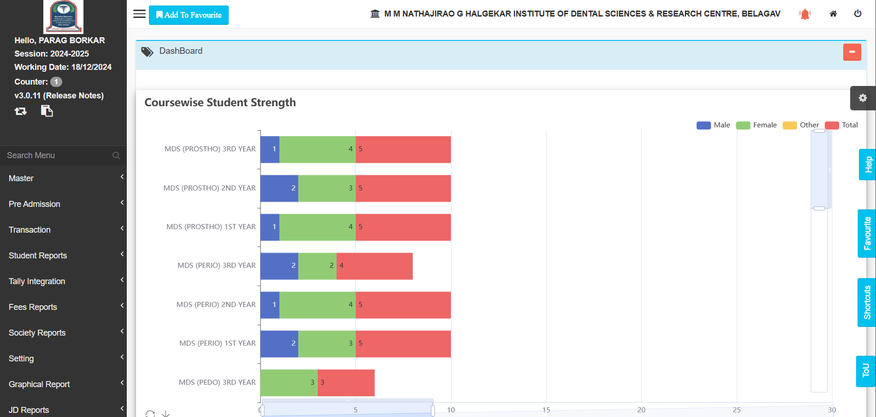
Academic Section

Slide 4
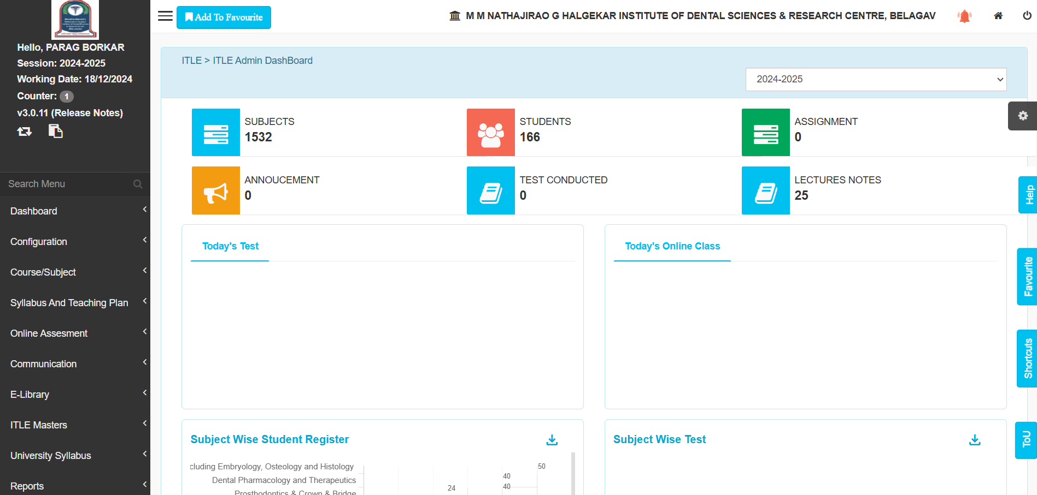
Teaching Activities

Slide 5
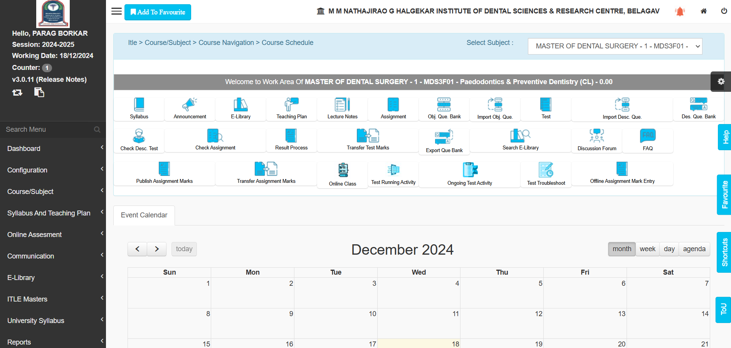
Learning Activities

Slide 6

Feedbacks

